Slide 1
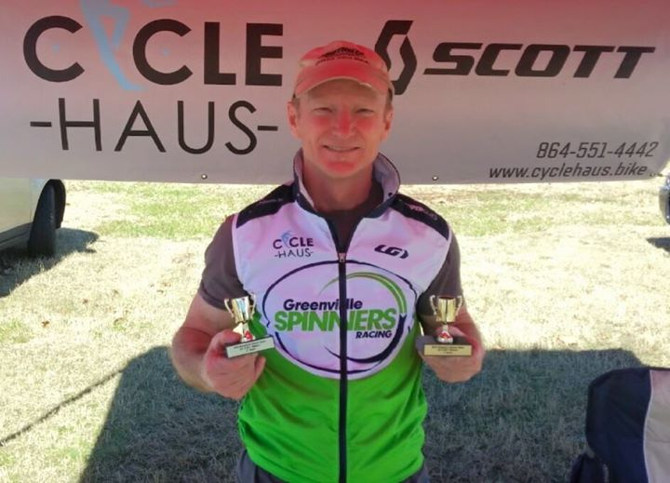
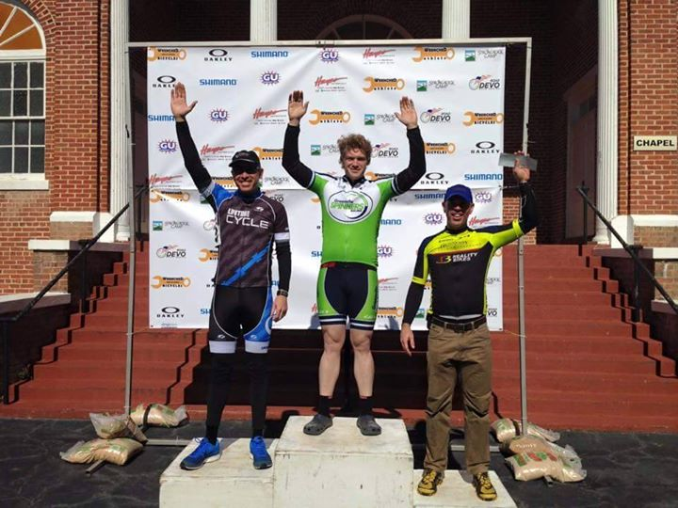
RACE your bike!
The Greenville Spinners Racing Team is recruiting now
for the 2016 season!!
Our team is made up of men and women of all ages (19 & up) and all levels of racing experience, from beginners who have never raced to veterans who have been racing for 30+ years.
This year, the team has placed a winner on the podium in Cat 5, 4, 3 and Masters races.
Come be part of our team! If interested in learning more, don’t delay… We are ordering 2016 kits in early November. Call Rip Major at 864-430-5206, email: racing@greenvillespinners.org or respond at https://www.facebook.com/GreenvilleSpinnersRacing/

